Slide 1
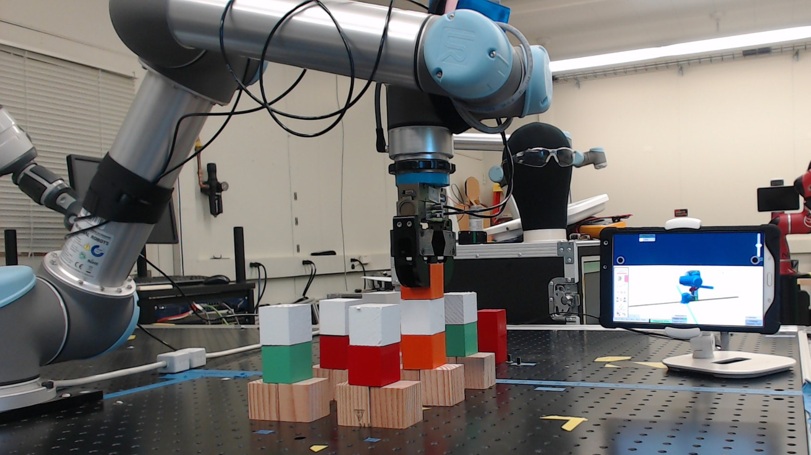
Adaptive Metrics and Performance Analysis Tool for Human-Robot Interaction
Author: Esteban Segarra Martinez;
Mentors: Shelly Bagchi, Dr. Jeremy Marvel, Megan Zimmerman

Slide 2
Introduction
Collaborative Robotics is an emerging field of robotics where the core concept is improving the interaction feedback between human and robot.
When a human utilizes a robot, the user experience of utilizing the robot is called human-robot interaction (HRI)
NIST is creating test methods and metrics that can quantify the user experience between human and robot.
Figure 1 – Human-robot interaction
NIST Engineering Laboratory

Slide 3
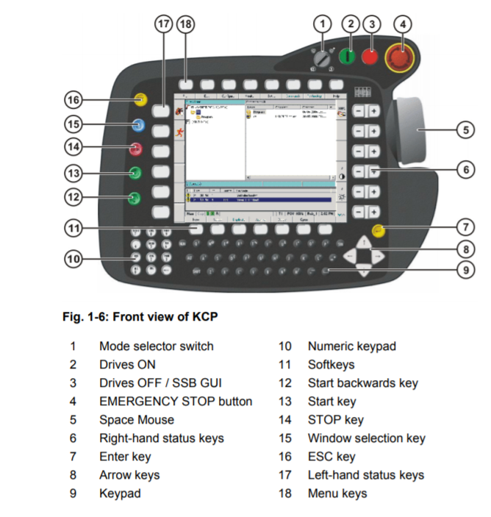
Background
The quality of HRI depends on the effectivity of human-machine interfaces (HMI) or human-computer interfaces (HCI) to provide feedback to the operator
Small and medium manufacturing industries are concerned for user interfaces that can help cut down on employee training
HMI is used by an operator for control and feedback on a robot system and varies widely in operation and appearance
Figure 2 – Industrial Controller
NIST Engineering Laboratory

Slide 4
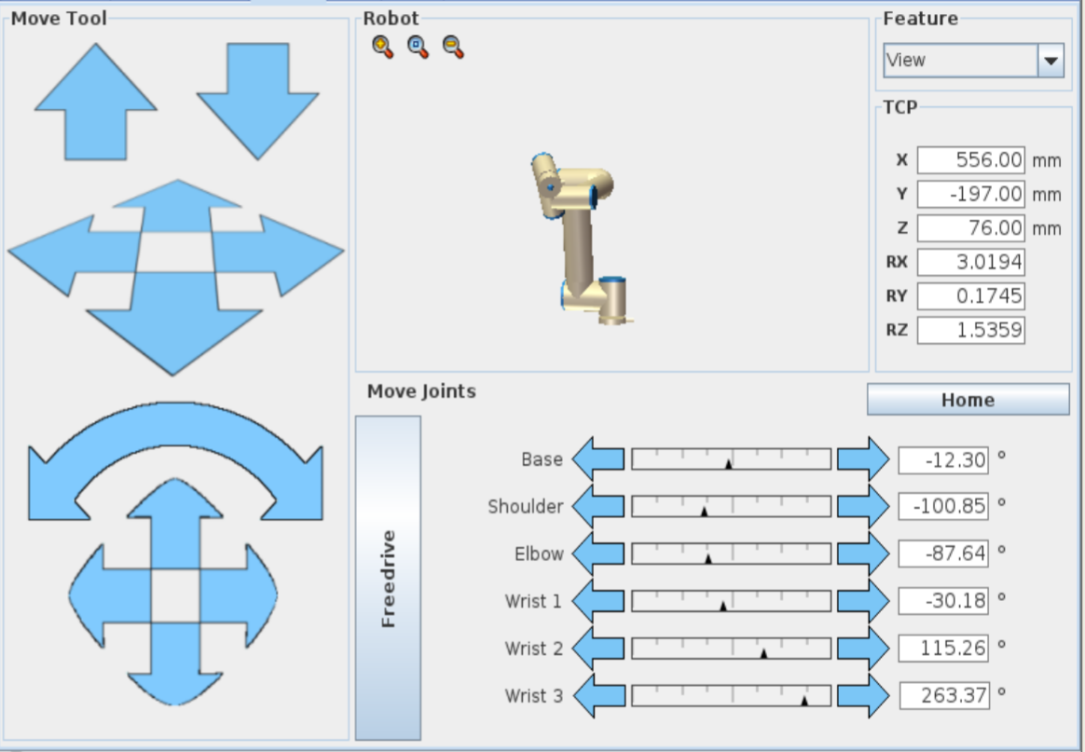
Figure 3 – UI design choice for an industrial robot
NIST Engineering Laboratory

Slide 5
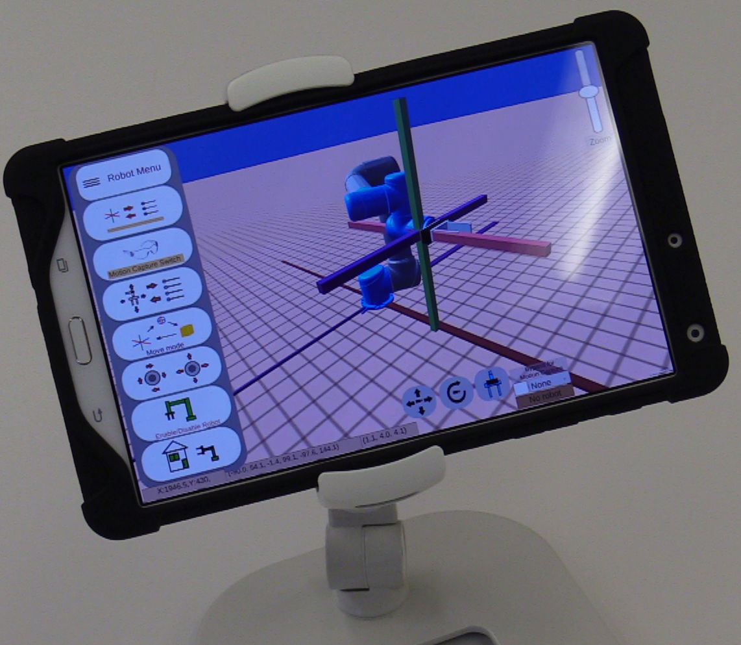
Objective
Recreate industrial controllers with different layouts and features in a user interfaces
Quantify the user experience while utilizing the user interface (UI)
Through application of an industrial case study, determine the performance between the application of different UI
Figure 4 – User interface controller
NIST Engineering Laboratory

Slide 6
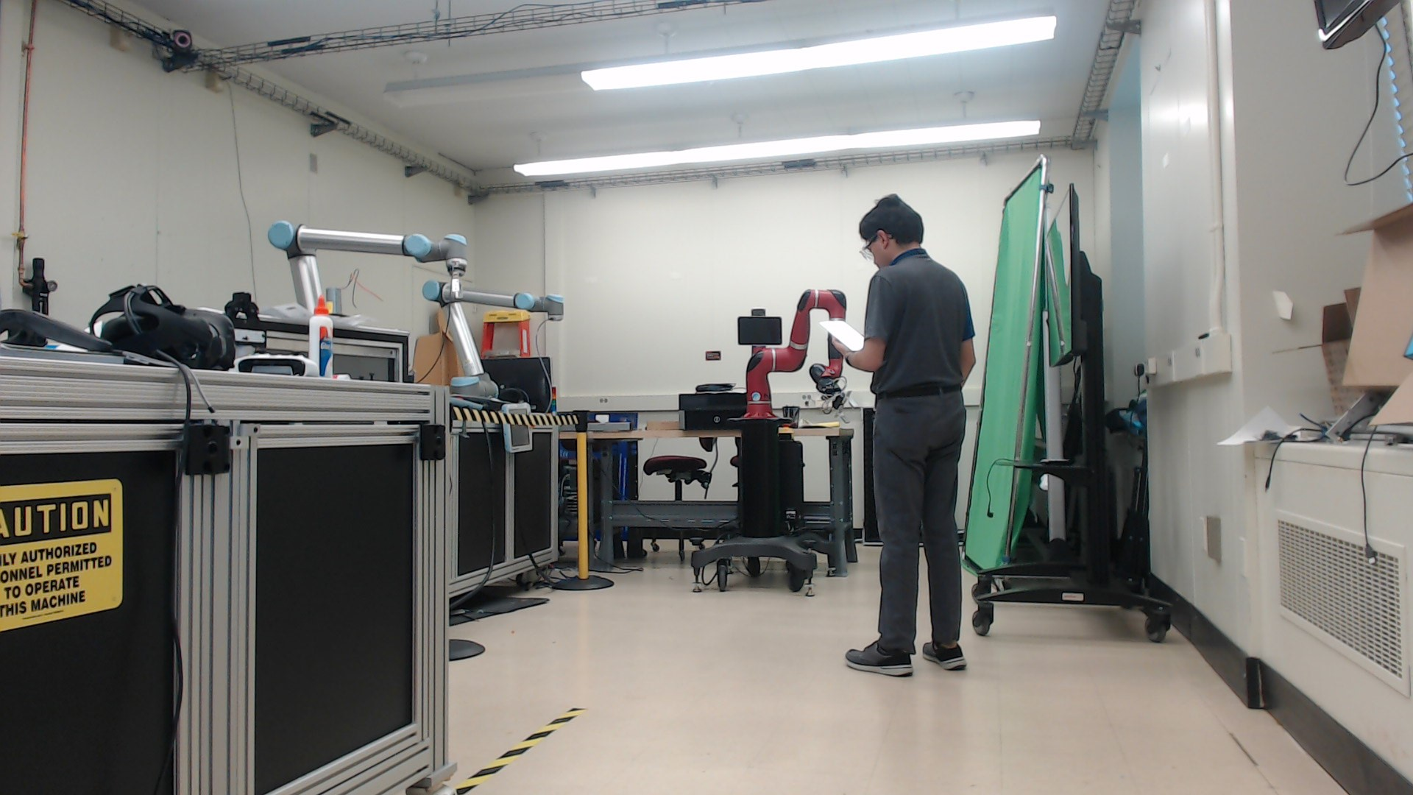
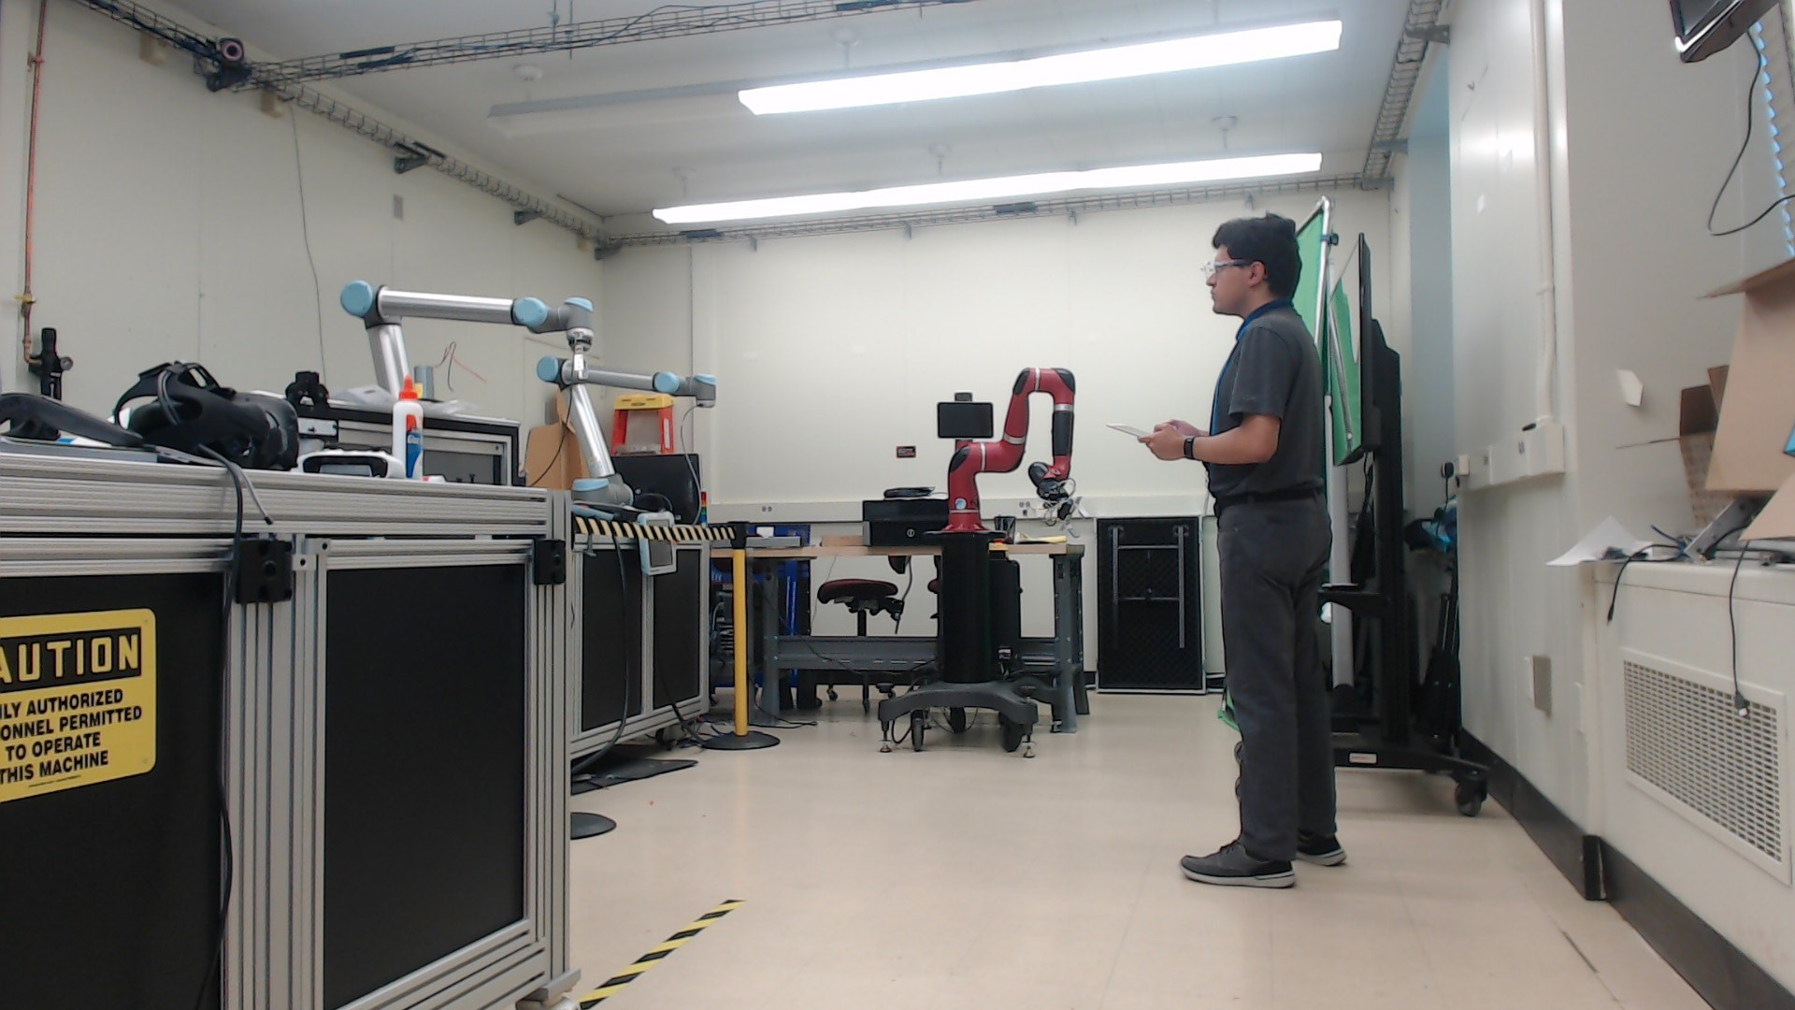
Methodology
Are my controls being acknowledged?
Are the controls enabled, is it safe to use?
Figure 5 – A user asks if its safe to use
Figure 6 – A user requests feedback
NIST Engineering Laboratory
Notes:
To determine good quantitative metrics for HMI, different types of interfaces should be designed. These interfaces should allow the user to experience different features of the interaction or task.
Researchers can determine what features of control, feedback, and overall layout would work most effectively for users using the interface by experimenting with different layouts and measuring for one of the following metrics
Effectiveness
Efficiency
Reaction time
Precision of control
Researchers can test for these metrics by presenting a user interface to a novice or people with no prior experience to an interface with a robot and determine its ease through the reaction the user has.

Slide 7
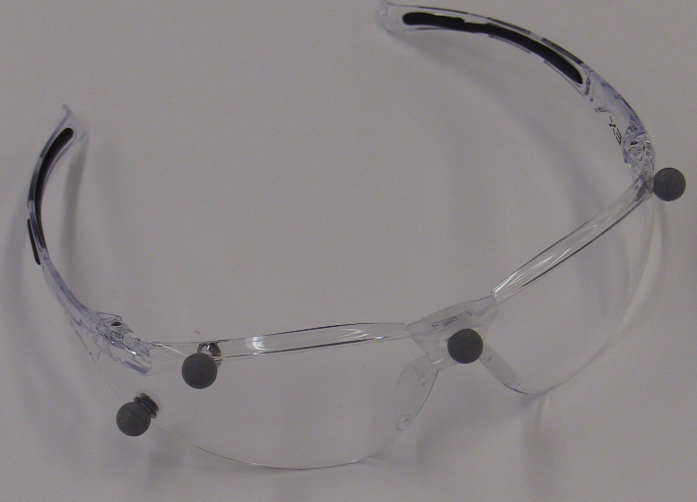
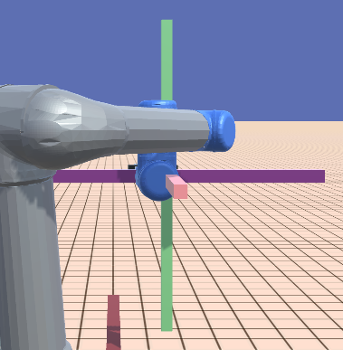
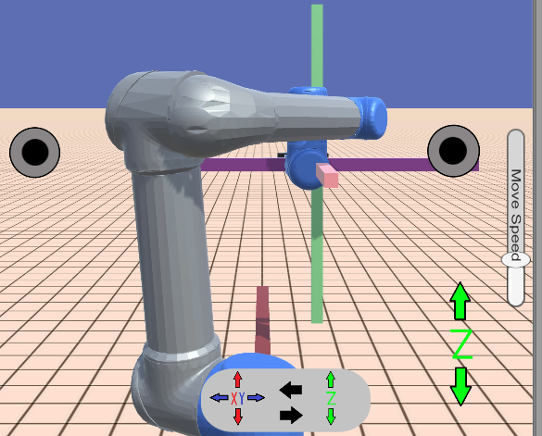
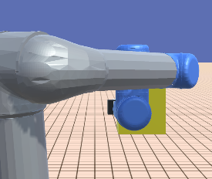
Methodology - Continued
Differences in layout, features, and design influence user experience
Changing the user experience can determine changes in the human-robot interaction
Figure 7 – Motion capture external controls
Figure 8 – XYZ control
Figure 9 – Joystick control
Figure 10 – Freemode control
NIST Engineering Laboratory

Slide 8
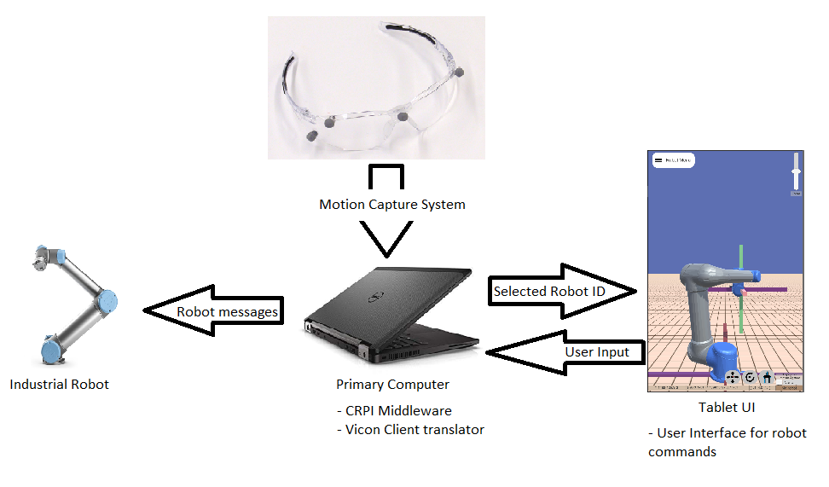
Setup
Figure 11 – System Overview breakdown
NIST Engineering Laboratory
Notes:
Collaborative Robotics Programming Interface (CRPI) allows the computer to relay commands from the tablet to the robot arm
Unity instance calculates the position of items and determines what robot is the user looking at

Slide 9
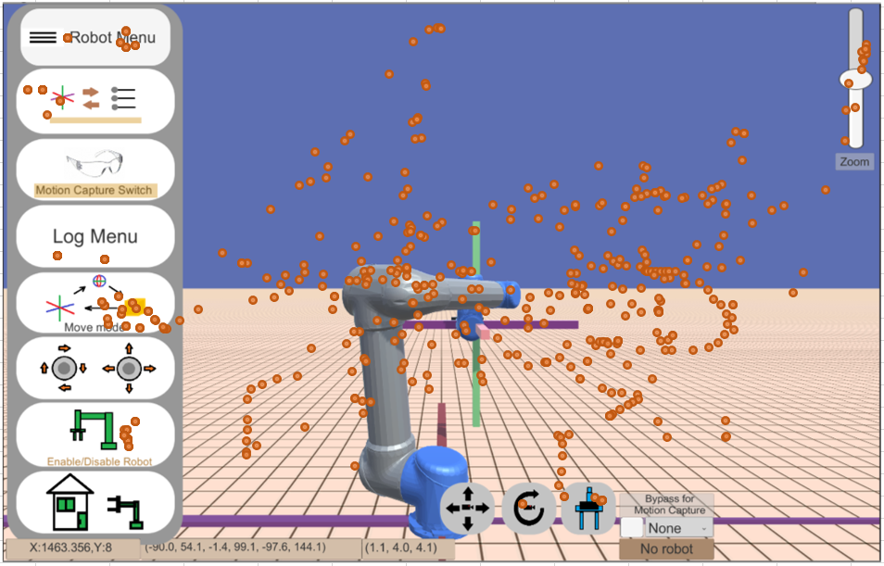
Setup
Unity records motions perceived from the tablet such as the position of the touch and which buttons are being pressed
The layout can be changed around as desired with different tasks being applied
Figure 12 – Touchscreen heatmap from user
NIST Engineering Laboratory

Slide 10
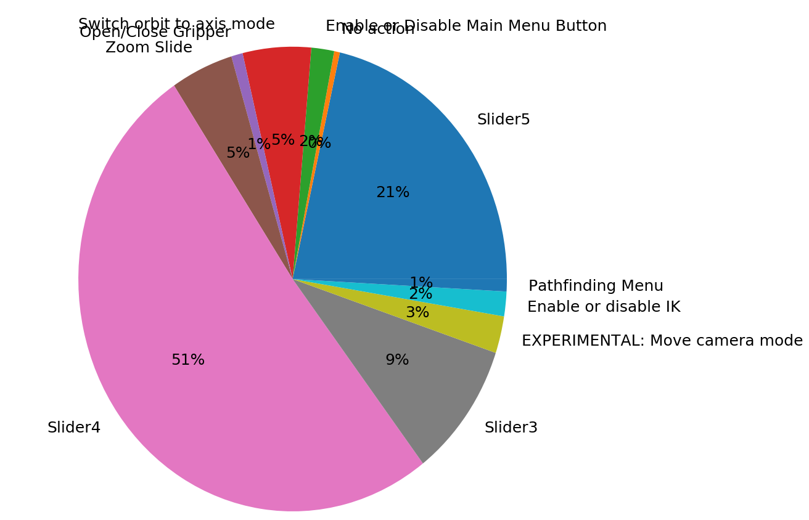
Setup
Figure 13 – Pie chart of popular buttons that were pressed
NIST Engineering Laboratory

Slide 11
Video Demonstration
x8 Speed
NIST Engineering Laboratory

Slide 12
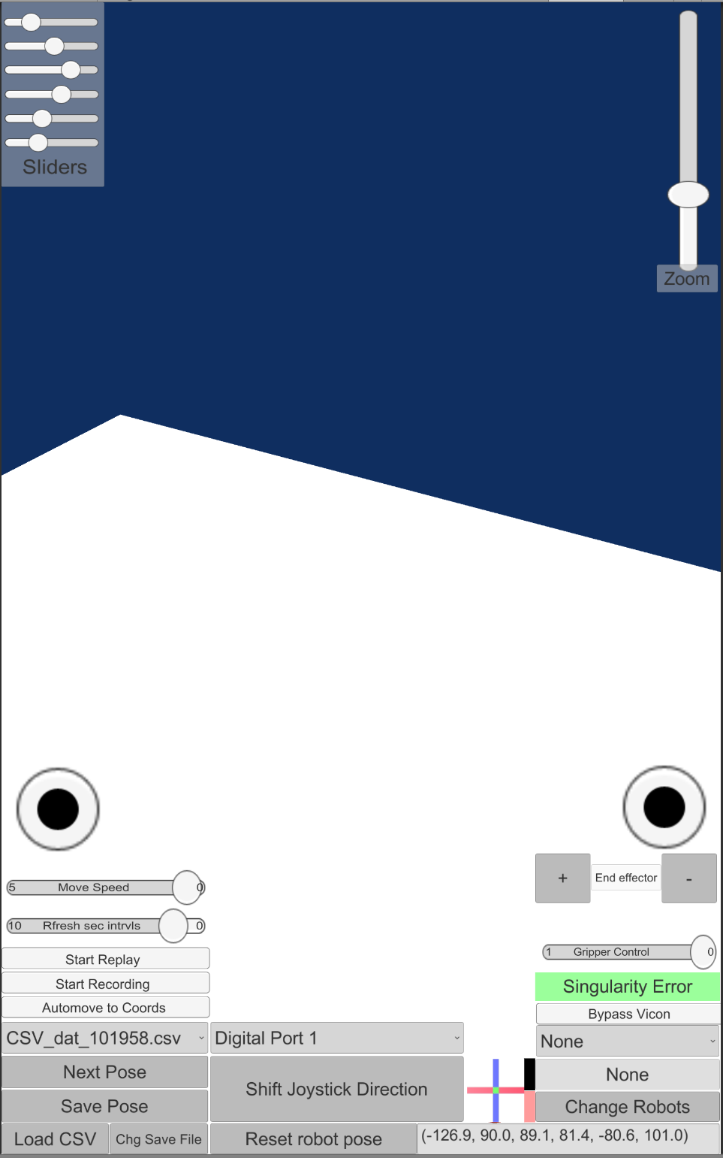
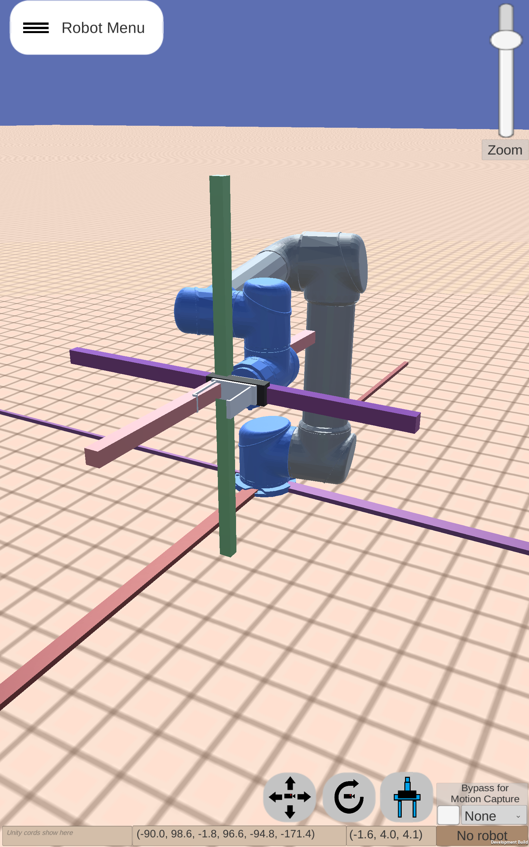
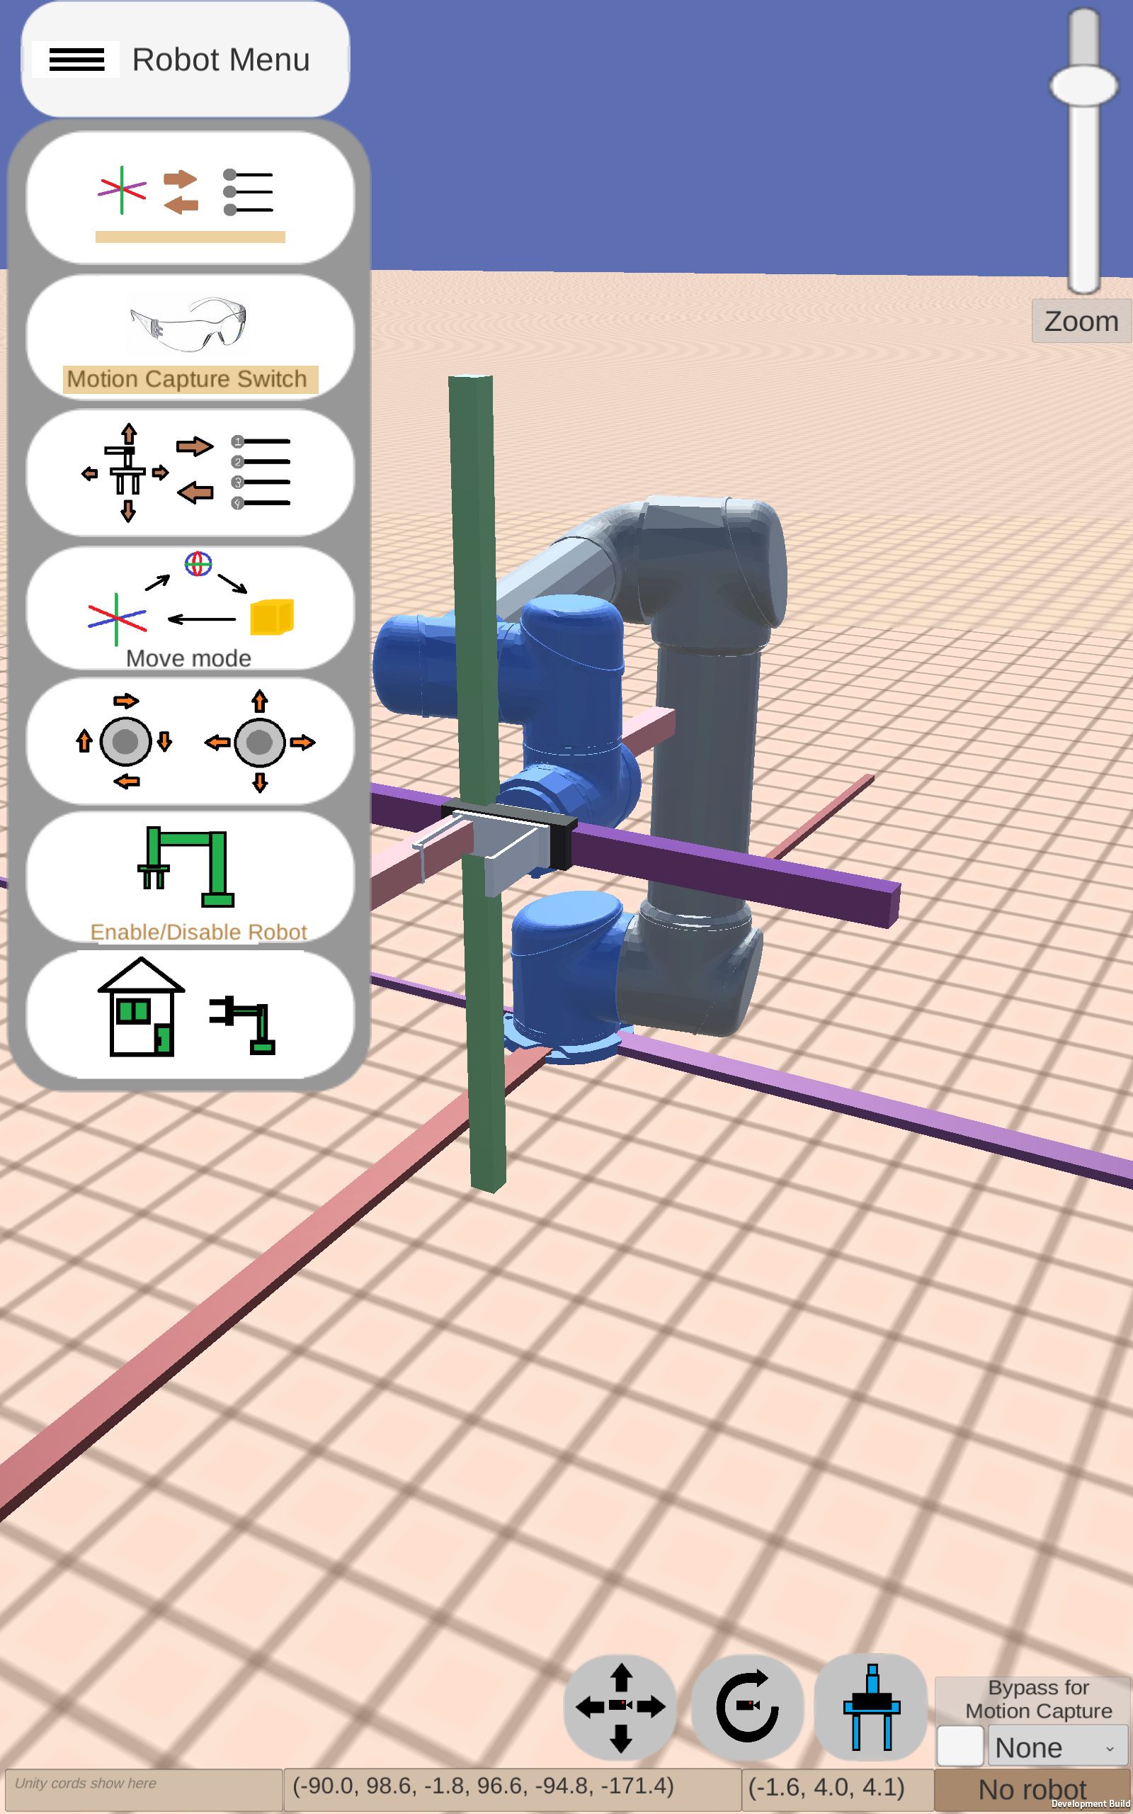
Final Interface
Figure 14 – Example of a first-generation interface
Figure 15 and 16 – Example of a Structured Interface
NIST Engineering Laboratory

Slide 13
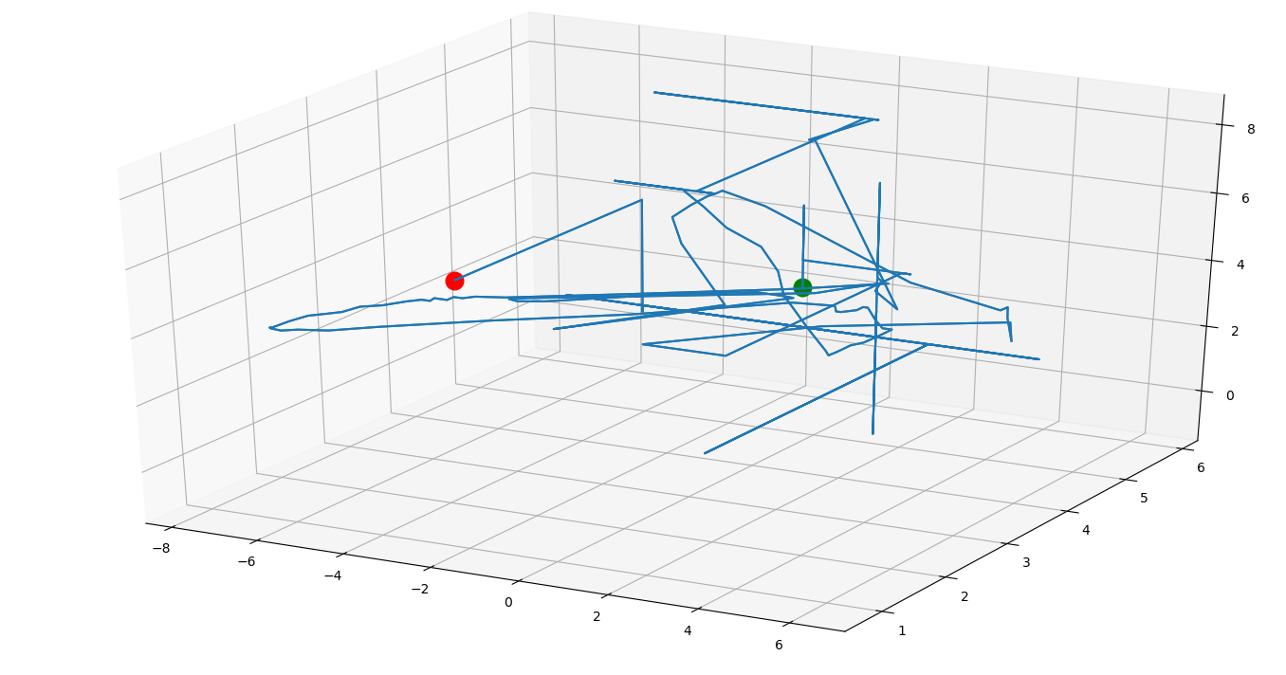
Results
End
Start
Figure 18 – 3D map of end-effector movement as used by the user during a trial.

Slide 14
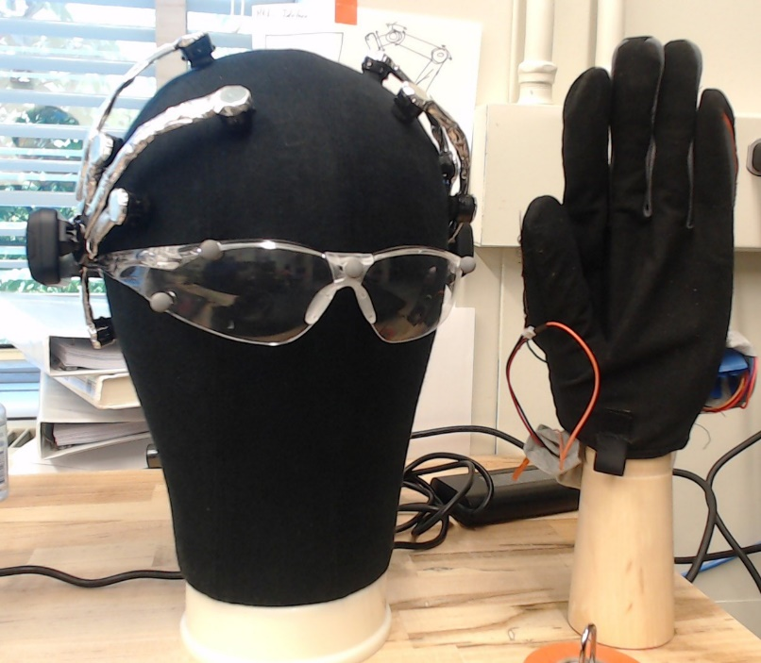
Conclusion and Future Work
NIST will be conducting human trials to obtain more conclusive results on these technologies
These studies will be looking at the use of state-of-the art technologies such as virtual reality, augmented reality, brain-computer interface (BCI), or wearable technologies
Future work will narrow down which types of technology can potentially allow users to control a robot more easily or in a more natural manner
Figure 19 – Examples of future testing equipment including wearable and brain interface technologies
NIST Engineering Laboratory

Slide 15
Questions?
Special thanks to:
Jeremy Marvel
Shelly Bagchi
Megan Zimmerman
Project Files are available on GitHub
https://github.com/usnistgov/CRPI
https://github.com/OvercodedStack/ANDROID_UNITY_UI-Summer-2019-NIST/tree/Android-Branch
https://github.com/OvercodedStack/MOTION_CAPTURE_UNITY-Summer-of-2019-NIST
https://github.com/OvercodedStack/CRPI_MIDDLEWARE_INTEGRATION-Summer-of-2019-NIST
https://github.com/OvercodedStack/CRPI-UI-DOCUMENTATION-Summer-of-2019
Thank you for NIST SURF 2019!

Slide 16
NIST Disclaimer
Certain commercial equipment, instruments, or materials are identified in this paper to foster understanding. Such identification does not imply recommendation or endorsement by the National Institute of Standards and Technology, nor does it imply that the materials or equipment identified are necessarily the best available for the purpose.
NIST Engineering Laboratory

Slide 17
References for Images
Amazon.com for image for Latitude E5570
Universal Robotics for UR5 image
NIST Engineering Laboratory

Slide 18
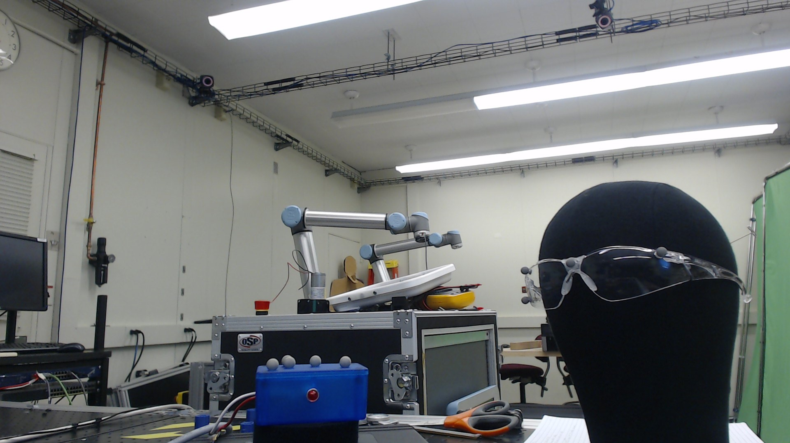
Motion Capture Setup
Motion Capture System
Motion Capture Objects
Figure 9 – Motion capture parts
NIST Engineering Laboratory

